Slide 2
End Sem Presentation
Implementing Compression Algorithm and Secure Transmission over UDP Protocol
TEAM MEMBERS
Project Guide
Harsh Narain Mathur R100218020
Harshit Chauhan R100218021
Pranay Mahajan R100218037
Mr. Ankit Vishnoi
Assistant Professor
Department of Systematics

Slide 3
PROBLEM STATEMENT
To implement Word-based lossless compression algorithm for text files by exploiting the redundancies in the text, compressing it to represent the input file in less space and simulating channel transmission over UDP protocol. After complete reception, de-compressing it to retrieve the original text file.

Slide 4
OBJECTIVES
To establish a connection between CLIENT and SERVER using socket programming.
To implement compression algorithm to compress the text file.
To implement de-compression algorithm to de-compress the text file.

Slide 5
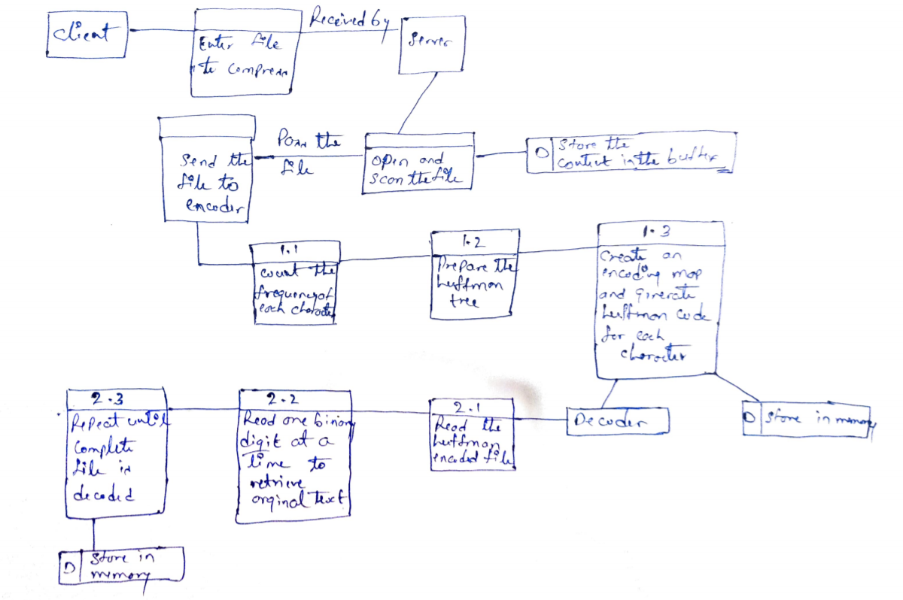
DFD

Slide 6
Algorithm for Socket Programming
Steps to create a client
Create a socket using the socket() function in c.
Initialize the socket address structure as per the server and connect the socket to the address of the server using the connect();
Receive and send the data using the recv() and send() functions.
Close the connection by calling the close() function.
Steps to create a server
Create a socket using the socket() function in c.
Initialize the socket address structure and bind the socket to an address using the bind() function.
Listen for connections with the listen() function.
Accept a connection with the accept() function system call. This call typically blocks until a client connects to the server.
Receive and send data by using the recv() and send() function in c.
Close the connection by using the close() function.

Slide 7
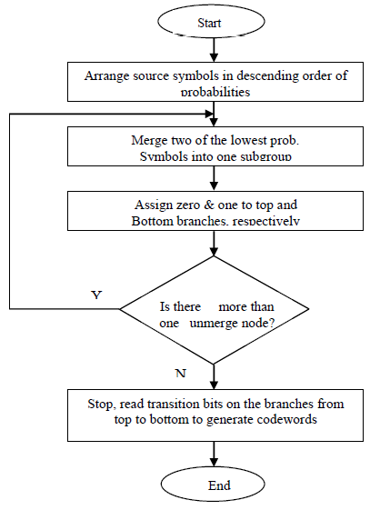
HUFFMAN ALGORITHM

Slide 8
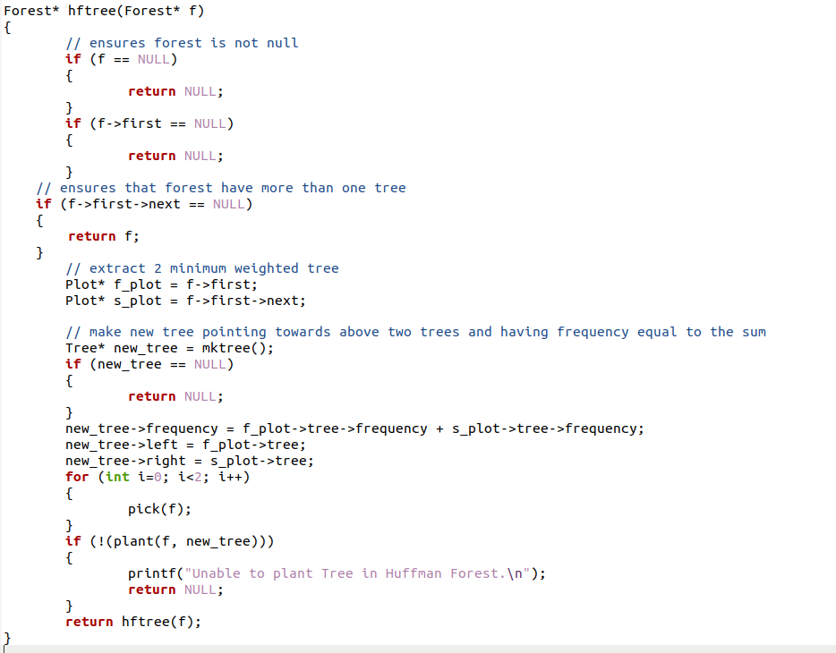
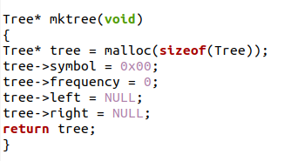
HUFFMAN ENCODING

Slide 9
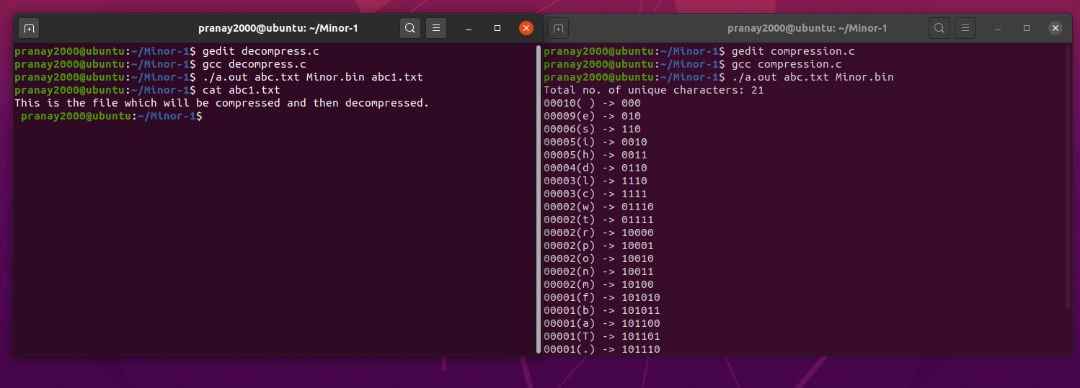
OUTPUT SCREENS

Slide 10
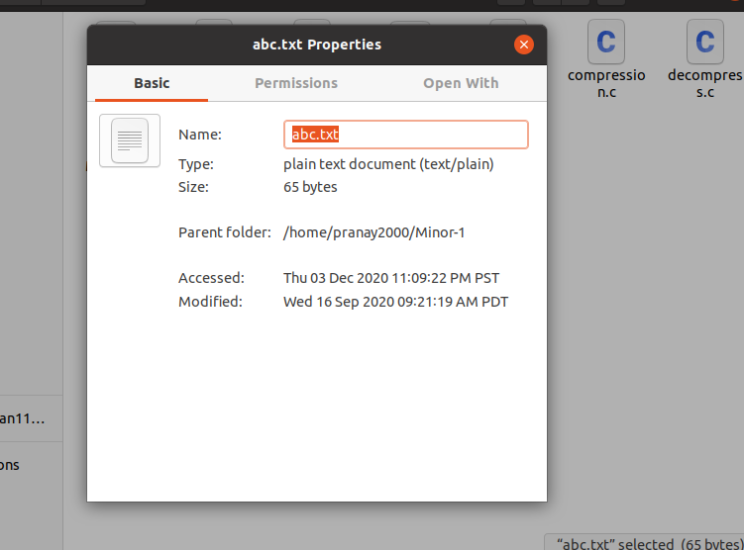
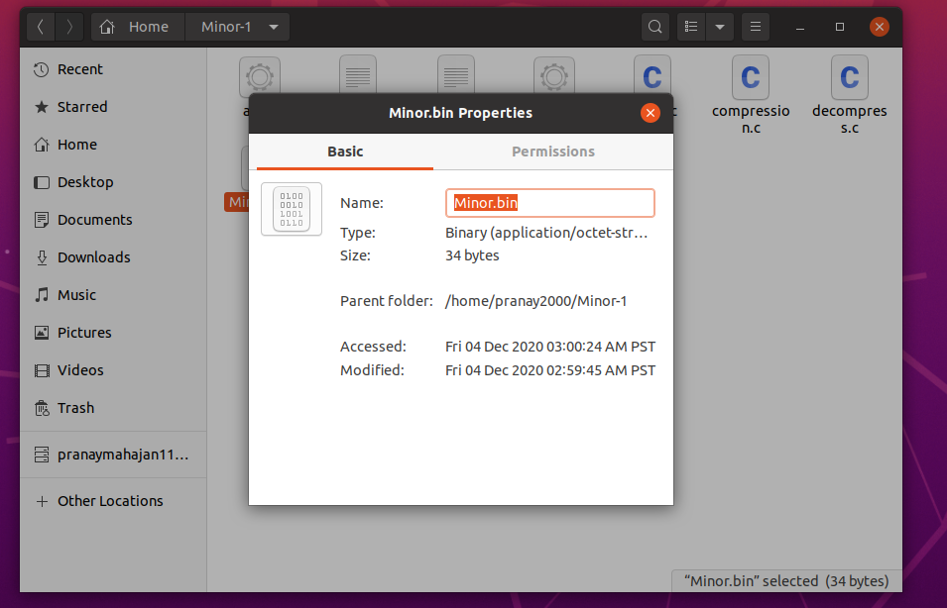

Slide 11
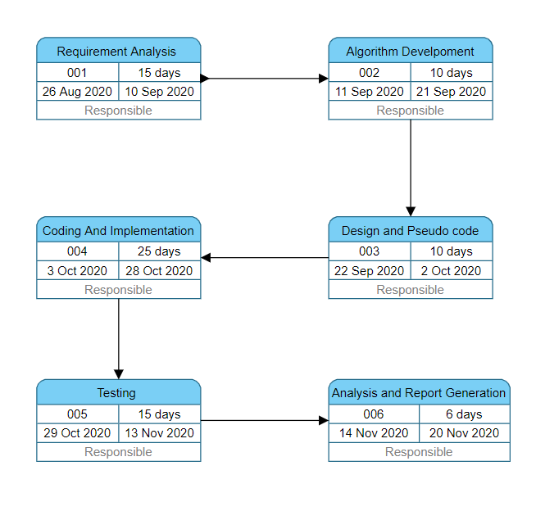
PERT CHART

